Slide 1
A murine model of glucocorticoid myopathy alleviation using androgen therapy
Nicolae Lucian Sandor
July 13th, 2015
Notes:
Welcome. Today I will tell you about the insights I gained into glucocorticoid myopathy and its alleviation by androgen co-administration using an animal model. First, we need to define a few terms. What is glucocorticoid myopathy? In fact, what are glucocorticoids? NEXT

Slide 2
Glucocorticoids in humans
Stress hormones working towards hyperglycemia
Abnormally increased cortisol in Cushing’s syndrome.
Activate immunosuppressive mechanisms.
Prescribed to ~1% per annum.
Effects include
insulin resistance
osteopenia
muscle loss.
Less specific glucocorticoids cause edema.
Notes:
Glucocorticoids are a class of steroid hormones. You may have heard of cortisol as a “stress hormones”, meaning they are increased in various stress conditions, such as heart failure. Their main effect is increased blood sugar, that is, hyperglycemia. Hence the name. NEXT.
We learned a lot about what glucocorticoid effects from a condition called Cushing’s syndrome. Around the fifties, doctors understood that Cushing’s syndrome is caused by excess glucocorticoids secreted by an endocrine cancer. In addition to hyperglycemia, an interesting effect is immunosuppression. Once chemists learned how to purify glucocorticoids, physicians started using them for the treatment of immune exacerbations. First it was rheumatoid arthritis. Later, glucocorticoids were employed as drugs in blood cancers that cause increases in circulating immune cells. We even have over the counter glucocorticoid creams for skin rashes. NEXT.
So now, 1% of people in this country receive some sort of glucocorticoid treatment in any given year. Today we have a much higher risk of glucocorticoid excess from pharmacy than from gland conditions. And many of the glucocorticoid users complain of side effects. In time, increased glycemia causes insulin resistance. Excess glucocorticoids also cause loss of bone – osteopenia – and loss of muscle. NEXT
One side effect we won’t talk about today is edema, meaning increased water retention in peripheral tissue. Less specific glucocorticoids can cause that too. But I will be focusing on the more specific glucocorticoids. The best example of specific glucocorticoid is dexamethasone, which is a synthetic glucocorticoid, modified by fluoridation to be more potent and more specific. NEXT

Slide 3
Glucocorticoid myopathy
Complaint of 50% of patients.
Objective loss of force, volume.
Electromyography demonstrates it is a myofiber condition.
Can be modelled in vitro.
Increased urinary nitrogen, methylhistidine.
Treatable by cessation, inhibitors, anabolic adjuvants.
Notes:
So what is glucocorticoid myopathy? Glucocorticoid myopathy is the loss of muscle seen with excess glucocorticoids, be they from pharmacy or from oversecreting cancers. In surveys, more than half of patients with hypercortisolism of either cause complain of muscle weakness. Textbooks describe it as proximal, meaning that complaints are more often about the thighs than the toes. NEXT
Although glucocorticoids may have effects on the brain, glucocorticoid myopathy does not originate in the brain. The weakness patients complain about is a loss of force. With modern imaging techniques, such as MRI, we see that excess glucocorticoids make muscles visibly smaller. NEXT
Electromyographic studies indicate that excess glucocorticoids specifically impact on the myofibers, that is, the long, multinucleate contractile cells of the muscle. This is important, because it shows this is not a condition of the neuron, of the vessel, or of the tendon. That is why it is called myopathy and not neuropathy. NEXT
Another consequence of the fact that glucocorticoids hit the myofiber is that the condition should be easy to model in a dish. You should just pluck some myofibers from a living being, put them in a cell culture dish, add dexamethasone, and see what happens. NEXT
Human studies show that people with excess glucocorticoids have increased urinary nitrogen. Nitrogenis stored in the body in proteins, so that means excess glucocorticoids cause more of the protein to be degraded. In fact, it’s not any protein that is degraded. Urine of these people have increased methyl histidine. Histidine is an amino acid, part of almost all proteins in the body, but it is methylated only in the muscle, when it is part of actin and myosin. An increase in methylhistine in urine demonstrates that glucocorticoids stimulate protein degradation in muscle. NEXT
So what do you do to a patient with glucocorticoid myopathy? If it’s coming from a pill, you stop it. If it’s from a cancer, you excise it. But there are times when surgery is not an option because the source of cortisol is disseminated, spread in the body. And there are serious cases of blood cancer, when you cannot stop the glucocorticoid therapy. You may give a receptor inhibitor, but those are not very specific and may defeat the purpose. You end up having the patient living with the excess glucocorticoid. In these cases, the doctor will just have to fight the muscle loss with some anabolic therapy. Certainly, you may recommend a beter diet, with more amino acids, but more commonly, when we say anabolic therapy, we think of anabolic steroids. NEXT

Slide 4
Testosterone to the rescue?
Effective in sarcopenia of aging, HIV+.
Causes increase in protein synthesis, intramuscular IGF-I.
Hypercortisolism reduces testosterone.
Anecdotal: was standard of care until 1980’s.
Crawford et al. (2003) showed Testo addition to chronic GC causes:
higher bone density
improved muscle mass and strength
better quality of life.
FDA warnings are not helping.
Notes:
The most common kind of anabolic steroid is testosterone. From clinical trials we know that it helps preserve muscle mass in aging men whose testosterone levels are naturally declining. It also helps in men with HIV whose muscle ae atrophying. NEXT
The way testosterone works may differ from condition to condition and is still studied. Most commonly, clinical studies report that in men treated with testosterone, protein synthesis rate increases. Testosterone may also stimulate synthesis of another anabolic factor, insulin-like growth factor. Again, this may differ from condition to condition. NEXT
On the other hand, men with hypercortisolism have lower – still normal, but lower – testosterone. This suggests that these men may benefit if they receive testosterone supplementation, to restore their circulating testosterone levels to that of their peers. NEXT
Between the sixties and the eighties, the modern imaging techniques such as MRI were not available. In those days, it was more common for cancers to go unfound. You don’t need a big bump to get excess cortisol secreted. So many patients had to live with increased glucocorticoids in their blood. In those days, testosterone was frequently given for loss of muscle due to hypercortisolism. While no trials and no large-scale observational studies were done, it appears, at an anecdotal level, that testosterone was beneficial in these cases. NEXT
In modern times, there has been a clinical trial with good statistics and good outcome measurements. The trial enrolled men who received prednisone for lung disease, for an average of 8 years. In the beginning of the study, these men have weaker bones and muscle compared to other men of the same age. The men who were randomized to receive testosterone for a year got improved bone density, improved muscle force, and an improved quality of life. So there you have it: testosterone may be able to help men with glucocorticoid myopathy. NEXT
Unfortunately, testosterone will not move into practice soon. Repeatedly, testosterone is associated with more or less reasonable worries. In the nineties, it was thought that testosterone therapy increases your risk of prostate cancer. Nowadays, it’s thought it may increase the risk of heart attack. Even if there worries turn out to be unfounded, it will take a while until testosterone will be rehabilitated. So we need an alternative to testosterone, one that is both safer and perceived to be safe. In order to create testosterone alternatives, we need to better understand testosterone mechanisms. NEXT

Slide 5
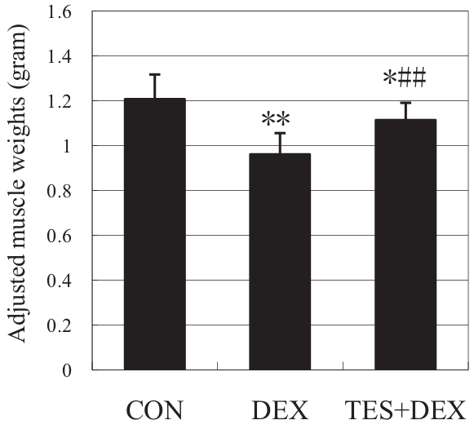
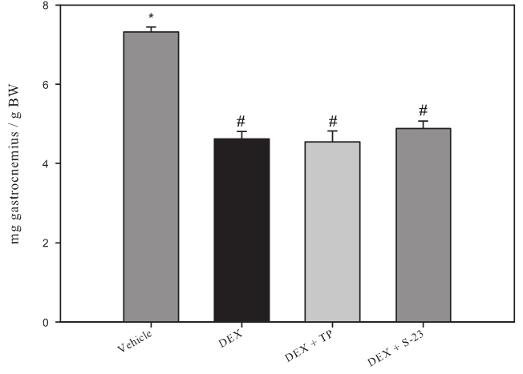
Rats may benefit from testosterone co-administration
Gastrocnemius.
Ten-day 1 mg/kg dexamethasone
± 5 mg/kg testosterone (Yin, J Trauma, 2009).
Gastrocnemius.
Eight-day 0.6 mg/kg dexamethasone
± 25 mg/kg testosterone (Jones, Endocrinology, 2010).
Notes:
Nobody is going to approve anytime soon a randomized trial with two drugs perceived as dangerous, although they are unbelievably commonly prescribed. We have to rely on animal studies. Early studies using farm animals, such as sheep, cows, rabbits, failed to model glucocorticoid myopathy. This failure is caused by another effect of glucocorticoids, which increased fat deposits. Cows have massive intramuscular fat deposits. There, glucocorticoids will shrink myofiber, and swell fat. In combination, cow muscle will get thicker and heavier, even if less functional. This is a common problem even when assessing human glucocorticoid myopathy. NEXT
More recently, studies have looked at rats. Many studies confirm that, in rats, muscle mass is reduced by dexamethasone, by nearly 20% in a week or so. Here, we see that adding testosterone is beneficial to the rat, whose muscle recovers to nearly the initial mass. So we may conclude that what we saw in Crawford study on humans may be replicated on rats. OK, I am not sure if rats’ quality of life got better, but their muscles surely got better. Or did they? NEXT
In another study, we see the same loss of muscle mass with dexamethasone, but here, testosterone does not seem to help any longer, despite being given five times more. So it’s a toss? No, it is not, there is a third group, which published even more through studies, and they vote with muscle protection. So all in all, there is a good chance that testosterone protects muscle from dexamethasone-induced atrophy. That would be a first hypothesis. NEXT

Slide 6
Hypothesis
Testosterone alleviates dexamethasone-induced muscle atrophy in mice.
Notes:
However, my first hypothesis will be even riskier. Given that our best, off the shelf transgenics are in mice, that the best microarray chips are for mice and so on, I became more interested in mice than rats. Mice do exhibit loss of muscle in response to dexamethasone, but no one has looked into whether testosterone could prevent that loss of muscle. NEXT
My first hypothesis is that testosterone alleviates dexamethasone induced loss of muscle mass in mice. The rest of the discussion is concerned with how is testosterone doing it. NEXT

Slide 7
Mechanisms of Dexa in rats
Increase in urinary 3MH.
Amino acid release decreases by 80% when co-treated with MG132.
Two E3 ligases (“atrogenes”) upregulated.
Other proteolytic mechanisms are involved.
Notes:
In order to understand how testosterone works, we need to focus on the specifics of this atrophy model. As I said, rats and dexamethasone have been a more common combination in literature. NEXT
There, we see the same increase in urinary methylhistidine, indicating that glucocorticoids stimulate protein degradation in muscle. Unfortunately, I am not aware of a method of accurately collecting 24 hour urine from mice, so it is not of much help for my studies. NEXT
Another rat experiment informs about the mechanism for this protein degradation. Say you take a rat and give it dexamethasone for a week. That puts it in a very catabolic state. If you sacrifice it and take a gastrocnemius muscle from it, you will see it exuding free amino acids from that highly proteolytic activity. So let’s say you put in a test tube with warm buffer one such muscle. And then you put the other, contralateral muscle in another test tube, with the same medium, but supplemented with MG132. This is a proteasome inhibitor. When you do that, you see that the dexamethasone-stimulated amino acid release is reduced to a fifth. So most of the bulk protein digestion is done by a proteasome-dependent system. NEXT
Recent genomics studies showed that, similar to other atrophy models, loss of muscle caused by dexamethasone is correlated with an increase in expression of two E3 ligases, enzymes that catalyze the last step in the ubiquitin-mediated proteolysis. So this is another line of evidence showing that muscle loss caused by glucocorticoids is reliant on the ubiquitin-proteasome system. NEXT
Before leaving preoteolysis aside, we must recall that 20% of the increase in protein degradation seems independent of the proteasome. So other proteolytic systems may be involved.

Slide 8
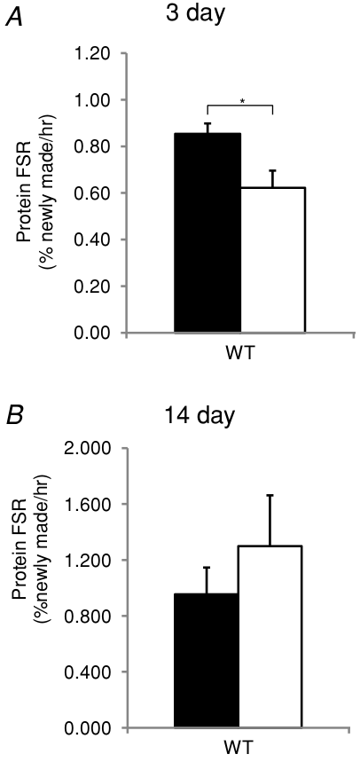
Protein synthesis and Dexa
3 mg/kg dexamethasone on male mice
(Baehr et al., J Physiol, 2012).
Notes:
There are a series of molecular clues that glucocorticoids, in addition to stimulating protein degradation, reduce protein synthesis. Unfortunately, studies looking directly at the rate of protein synthesis are rare and inconclusive. There have been a series of inconclusive studies in rats. In mice, protein synthesis rate is even less studied. In fact, this is the only study of protein synthesis rate in response to dexamethasone in mice. After three days, protein synthesis rate is reduced by dexamethasone. But after 14 days, protein synthesis is increased. Literature does not describe similar changes in protein degradation. This may mean that after sustained muscle loss, feedback mechanisms kick in, and protein synthesis responds. It also means that change in protein synthesis here, and in many other models of atrophy, is quite hard to prove. Choice of experimental conditions becomes very important. NEXT

Slide 9
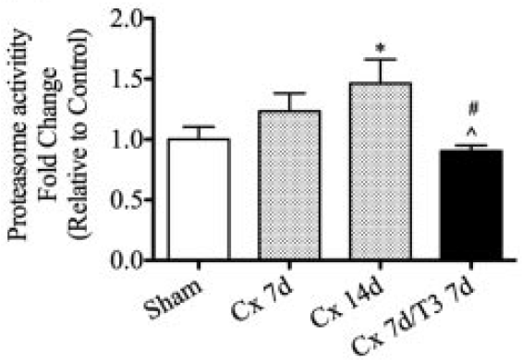
Testosterone effect on atrophying muscle
Often shown to improve protein synthesis.
Recently shown to inhibit protein degradation:
Ferrando et al., 2003, in burns.
Serra, Sandor, Bhasin, et al., 2013, in castrated mice.
Serra et al., Endocrinology, 2013.
Notes:
So how is testosterone working? As I said, it may depend from condition to condition, but in many other conditions, it improves protein synthesis rate. Recently, it has been shown that muscle may also lower the rate of protein degradation.
In Texas there is a group that measures proteasome catalytic activity in men receiving testosterone. They had shown testosterone’s protective effect in people with burns. Now, burns cause muscle loss and an increase in cortisol. It is not clear how effective is hypercortisolism in the burned. But if hypercortisolism turns out to be a main cause of muscle loss in burns, proteasome inhibition emerges as an important muscle protective mechanism. NEXT
Another study was run by Dr. Bhasin in my first year in his lab. I volunteered the idea that proteasome catalytic activity may be a good readout of the ubiquitin proteasome system. Indeed, castrating mice led to rapid loss of muscle, especially in levator ani, a perineal muscle, very sensitive to levels of testosterone. There, the loss of muscle was correlated with increased proteasome activity and with atrogene expression. Giving testosterone back to these castrated mice restored their muscle mass, and repressed their proteasome activity.

Slide 10
Hypotheses
Testosterone alleviates dexamethasone-induced muscle atrophy in mice.
Testosterone’s myoprotective action includes an anti-catabolic component.
Notes:
Given the new information that we had about the anti-catabolic action of testosterone, I formulated a second hypothesis, which is that testosterone’s protective action must include an anti-catabolic component.

Slide 11
Glucocorticoids’ transcriptional effect
Myostatin
Klf15
GR
MuRF1
muscle
loss
Dexa
Foxo
4EBP
Notes:
Glucocorticoids are steroid hormones, meaning they act through so-called nuclear receptors which directly stimulate some genes’ expression. Sometimes these nuclear receptors may inhibit some gene’s expression, or interact with cytosol proteins, but let us look first at typical transcriptional effects of dexamethasone. NEXT
The most easily detectable effect of dexamethasone is stimulation of those two atrogenes. Among them, MuRF1 seems the more important, because its knockout halves muscle loss induced by excess glucocorticoids. But atrogenes do not seem directly induced by glucocorticoid receptor. The most probable way towards atrogenes upregulation uses Foxo transcription factors. NEXT
Foxo transcription factors contain, in their promotor, glucocorticoid responsive elements. In turn, MuRf1 contains Foxo responsive elements. NEXT
Another contributor is the transcription factor klf15. On one hand its promoter contains proven glucocorticoid responsive elements On the other, klf15 binds and activates the promoters of Foxo’s and atrogenes. NEXT
Dexamethasone stimulates expression of myostatin, a well-known negative regulator of muscle. NEXT
Finally, dexamethasone induces expression of a gene called 4E binding protein. The name explains its role. 4EBP binds and inactivates initiation factor 4E, which is required for initiating protein translation. Through expression of 4EBP, dexamethasone has a mean to shut down protein synthesis. NEXT

Slide 12
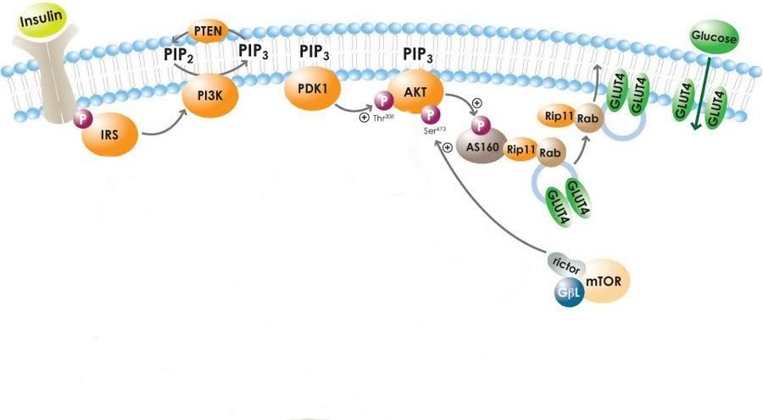
Insulin signaling desensitization
May, 2010
Glucocorticoids increase glucose and insulin, but lower glucose uptake.
Putative points of inhibition include IRS 1 and p85.
Notes:
In addition, there are less direct ways for dexamethasone to impose its muscle loss program. Remember that glucocorticoids cause hyperglycemia. They also cause increase in insulin. And yet, dexamethasone reduces glucose uptake into muscle. That is unusual, because insulin is supposed to stimulate glucose uptake into muscle. Somehow, dexamethasone and insulin fight it out, and dexamethasone wins. NEXT
This long pathway here shows what insulin does to normal muscle. Somewhere along this way, dexamethasone extinguishes insulin signals. NEXT
Two main candidates are best studied. First, glucocorticoids somehow repress expression of insulin receptor substrate, IRS, thus leaving the insulin receptor without its closest relay. NEXT
Further downstream, dexamethasone stimulates expression of p85 alpha, a subunit of PI3 kinase. This subunit is thought to prefer the cytosol, and therefore remove the whole of PI3 kinase from the membrane. A few groups show that p85 is sequestered in the cytosol by the activated glucocorticoid receptor.
So all in all, by the time insulin signal reaches Akt, insulin has extinguished it. How is that important? NEXT

Slide 13
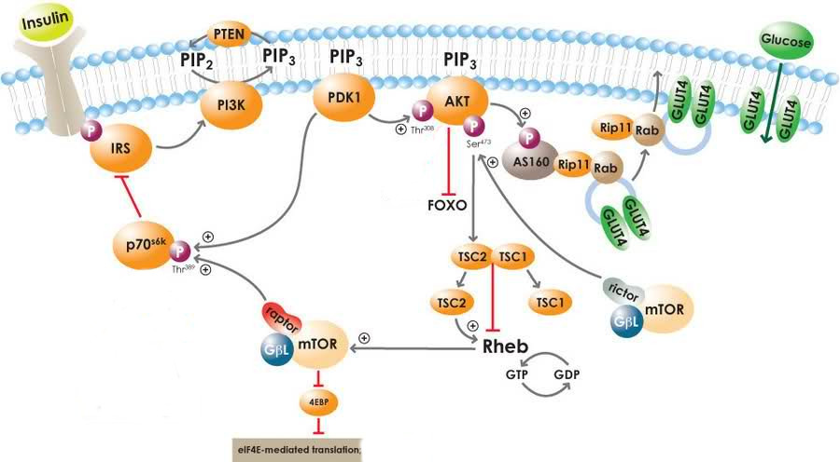
Results of Akt desensitization
Notes:
First, Akt is a kinase which inhibits by phosphorylation our old friends, the Foxo transcription factors. With dexamethasone suppressing insulin signals, there is less Foxo suppression from Akt. NEXT
Another acquaintance is 4EBP. Akt also suppresses 4EB, via the mTOR complex 1. Again, dexamethasone’s intereference in Akt signals will lead to less 4EBP suppression from Akt. NEXT
Finally, I wanted to mention this feedback loop. Insulin signals form a self-extinguishing circuit, meaning that dexamethasone effects may be also rapidly extinguished. So again, the choice of xperimental conditions may change the nature of the findings. NEXT

Slide 14
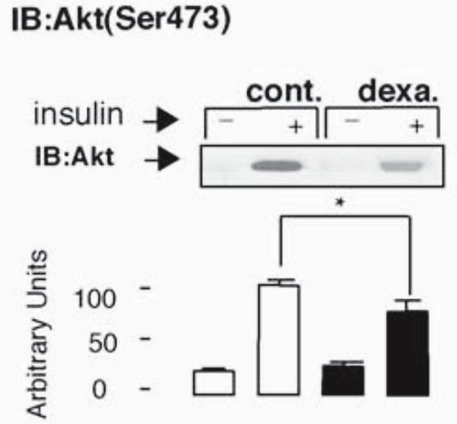
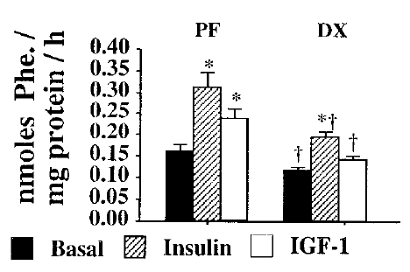
Insulin desensitization
Dardevet et al., J Endocr, 1998.
Rojas et al., Endocrin, 2003.
Also seen with IGF-I.
Dexa effect is easy to miss.
Notes:
What do I mean by that? Let us look at example. If you excise a muscle from a rat, and soak into in radioactively labeled amino acids, you may get a measurement of protein synthesis rate. If the animal was injected with insulin for 90 seconds before excision, the rate of protein synthesis doubles. A similar anabolic effect is seen if the animal is injected with insulin-like growth factor, IGF-I. NEXT
If the rat was treated with dexamethasone for a week, insulin is not as anabolic anymore. Protein synthesis still increases in response to insulin, but not as much. NEXT
Now, this experiment may be interpreted in a different way. We can instead look at dexamethasone effects. When no insulin was given, dexamethasone is repressing protein synthesis by 20%. NEXT
But when insulin is also present, dexamethasone’s effect appears ampler. Now repression of protein synthesis rate is more like 40%. So depending on conditions, the effects of dexamethasone on insulin signals may be seen more easily. NEXT
And this is an extreme example. In this study, activated Akt appears as unchanged in basal conditions, yet it is well suppressed when animals were treated with insulin shortly before sacrifice. This has been an important issue for my study, and I thib it’s worth pondering about it.

Slide 15
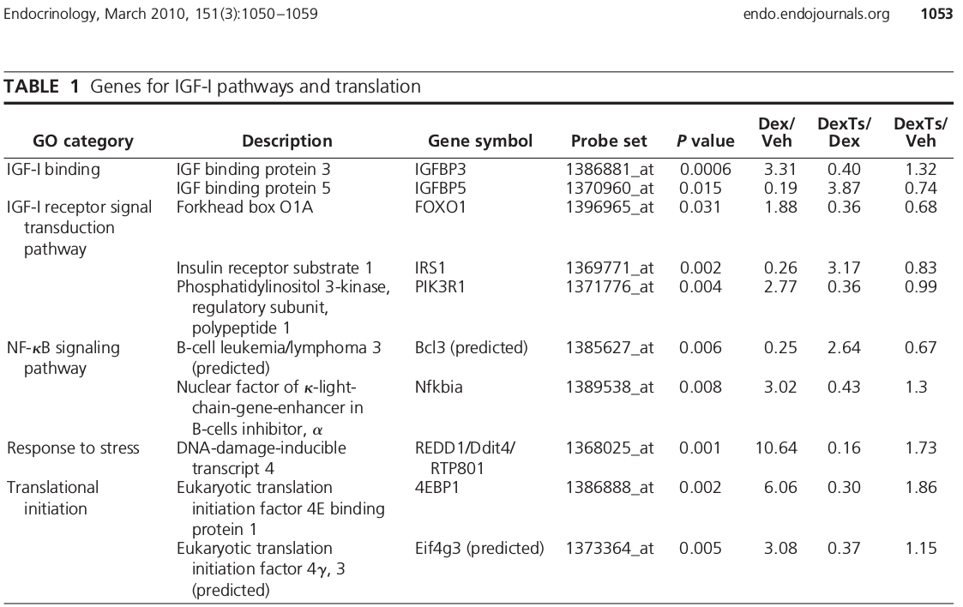
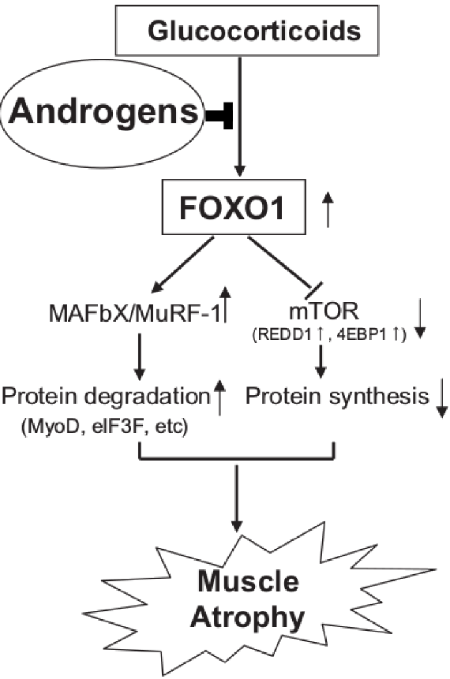
Foxo as mediators of testosterone muscle protection
Qin et al., BBRC, 2010.
Wu et al., Endocrinology, 2010.
Notes:
So what is testosterone doing in all this? Very little has been garnered from those three studies on rats. (And remember one of them actually declared testosterone ineffective.)
In a provocative way, the most recent of these studies ends with the results of a microarray. Usually you would see a microarray in the beginning of the study, followed by some confirmations of the findings in observational and interventional studies. Well, here we just had the microarray results.
Here we see the genes that were changed in one way by dexamethasone and in the opposite way when testosterone was coadministered. Interestingly, most of our old acquaintances are here: Foxo1, IRS1, p85 alpha, 4EBP. What is interesting is that not only Dexa had its usual effects on muscle, but testosterone seemed to repress each of these effects. So Cardozo came up with this model. NEXT
It appears that testosterone must act on the glucocorticoid signal early on, at its root, but what is there is not known. It is not the glucocorticoid receptor itself, because, as you will see, testosterone’s effect is limited to the muscle, and does not occur in adipose tissue. So who could be upstream of Foxo? One candidate is Akt, which, I said earlier, can neutralize Foxo. But testosterone does not act directly on Akt. PAUSE
Who is upstream of Akt then? Akt is at the core of insulin and IGF-I signaling, and IGF-I is stimulated by testosterone. So here is my third hypothesis.

Slide 16
Hypotheses
Testosterone alleviates dexamethasone-induced muscle atrophy in mice.
Testosterone’s myoprotective action includes an anti-catabolic component.
Testosterone’s myoprotective action relies on inhibition of Foxo facilitated by restoration of IGF-I.
Notes:
Testosterone’s myoprotective action relies on inhibition of Foxo facilitated by restoration of IGF-I.

Slide 17

In vivo test
± 10 mg / kg D, ± 28 mg / kg T
Tissue collection
V
D
Time (days)
D+T
Eight week old, male, C57BL/6.
Notes:
I set to verify these hypotheses in a mouse model. I took young adult black mice and randomized them to vehicle, dexamethasone, or a combination of dexamethasone and testosterone. The doses of dexamethasone that worked on rats did not work on mice. The studies on mice either show no data about muscle mass, or even state vague things such as “mice received 3 milliliters of water with dexamethasone a day”. And there was no data on testosterone for mice to begin with. I settled on these doses based on the macroscopic effect. NEXT
I weighted them every day before the injection. NEXT
With an NMR spectrometer, I measured their body composition at the beginning and the end of the week. NMR
Twenty four hours after the last injection, I sacrificed them and collected a series of muscles. NEXT

Slide 18
Progressive loss of body weight is alleviated by testosterone
body weight
(% gain)
Notes:
First, a word on the color convention. Black is for vehicle only, no steroid. Red is for dexamethasone-treated group. These are mice whose muscles sit at the red light, ok? And green is when the mice receive testosterone in addition to the dexamethasone. These testosterone-treated mice received the green light.
One thing that I saw from body weight was that the condition was progressive. As the time goes by, dexamethasone treated mice become lighter and lighter compared to the vehicle-treated controls. On the other hand, combination-treated mice get better and better compared to the dexamethasone-alone group.

Slide 19
Deeper in vivo probe
V
Tissue collection
D
Time (days)
D+T
V
Tissue collection
D
Time (days)
D+T
V
Tissue collection
D
Time (days)
D+T
Notes:
So I got worried that I might miss something important that trigger the whole condition, and is extinguished early on. So I ran the same kind of experiment, with other mice, which were treated with the steroids for shorter times. I got one set on mice treated one day, another treated for three days, and another treated for seven days. There are different mice treated at different times, different time of the year. As is, these are different experiments, it is informative when they agree, but you should not imagine a time course linking them.

Slide 20
Net effects on body weight become evident when treated for longer
body weight
(% gain)
Notes:
Looking at body weight alone, there isn’t much to see. Remember that cows lose muscle and gain fat when treated with dexamethasone? So it was interesting that seven-day treated mice appear to lose weight when treated with dexamethasone, and are rescued by testosterone coadministration, but let’s look at more specific information.

Slide 21
Testosterone has little effect on fat and partly restores lean mass
fat mass
gain (g)
lean mass
loss (g)
Only dexamethasone alters fat deposits.
Notes:
If you look at fat mas alone, mice appear to grow even with vehicle, because that is what I inject them with – corn oil. However, mice that receive dexamethasone gain even more fat, in a progressive manner. Adding testosterone to dexamethasone does not bring them down to basal levels. NEXT
Dexamethasone causes a progressive loss in lean body mass. With shorter treatments it is not as obvious, but in the seven day treatment, you can see the protective effect of testosterone.

Slide 22
Testosterone partly restores individual muscles
gastrocnemius (g)
triceps br. (g)
quadriceps (g)
levator ani (g)
one day
three days
seven days
one day
three days
seven days
Notes:
When you look at individual muscles, you see a similar trend. It is more obvious at day 7 that dexamethasone causes loss of muscle mass, but testosterone addition restores at least half of the loss. If you look at regular muscles, the effect of dexamethasone becomes apparent even at day three, while testosterone seems to take its time. In fact, if you look at that perineal muscle, levator ani, which is very sensitive to testosterone, you see that testosterone is also active in the three-day treated mice.

Slide 23
Conclusion so far
Testosterone reduces dexamethasone-induced reduction in mouse muscle mass.
Notes:
So in conclusion, testosterone reduces dexamethasone-induced reduction in mouse muscle mass. The loss of muscle is progressive, but so is the benefit of testosterone co-administration.

Slide 24
MuRF1 is restored to baseline levels by testosterone co-administration
gastrocnemius MuRF1 mRNA
quadriceps MuRF1 mRNA
gastrocnemius MAFbx mRNA
quadriceps MAFbx mRNA
one day
three days
seven days
Notes:
Having established that we have loss of muscle mass and prevention of that loss, I set out to find how could those occur. I hypothesized an anti-catabolic action for testosterone, but there are three proteolytic pathways, each supported indirectly by Cardozo’s microarray data in rats. My first option was the proteasome ubiquitin system, so I looked at that.
MuRF1 was upregulated in multiple muscle groups, at almost every time I looked at, by dexamethasone. This confirmed what we knew from knockout studies, which indicate a crucial role for MuRF1 in dexamethasone-induced atrophy. What was interesting is that, especially in the 3- and 7- day group, testosterone co-administration suppressed MuRF1.
A similar pattern was seen with MAFbx. Dexamethasone induced it, and testosterone suppressed it. Dexamethasone’s effect was not as ample (see day 3 gastrocnemius), again confirming what we knew from other studies. With less to repress, testosterones’s action on MAFbx was also less ample.

Slide 25
Chymotrypsin-like activity correlates with phenotype
quadriceps proteasome catalytic activity (rel.u.)
No ladder pattern of ubiquitinated myosin.
triceps proteasome catalytic activity (rel.u.)
three days
Notes:
When I measured proteasome catalytic activity, I found at day 3 a pattern that correlates with the phenotype, with dexamethasone stimulating proteasome activation, and testosterone repressing it toward basal levels. NEXT
I saw in a paper that, in atrophying muscle, myosin may appear as a ladder on immunoblot, indicating multiple ubiquitination states. I could not observe something like that, which probably explains why the finding was limited to one paper.

Slide 26
Dexamethasone represses autophagosome-associated genes
gastrocnemius beclin mRNA
gastrocnemius cathepsin L mRNA
gastrocnemius LC3 mRNA
one day
three days
seven days
Notes:
I then analyzed the autophagy pathway. In the world of dexamethasone studies there are two camps, those who see evidence of increased autophagy after dexamethasone treatment and those who don’t. OK, there is a third camps, those who switch camps. It’s not clear who is wrong, because there are no ideal ways of measuring autophagy.
I started by looking at some autophagy-related genes. When I looked at beclin, a gene essential for the formation of the autophagosome, I kept seeing that dexamethasone inhibited it at each time point. I looked at cathepsin L, the most important protease of the autophagosome-lysosome system, and dexamethasone did not amplify its expression either. I then looked at LC3, another autophagosome associated gene, and found the same lack of amplification.

Slide 27
Cathepsin L activity does not correlate with phenotype
gastrocnemius autophagosome catalytic activity (rel.u.)
quadriceps autophagosome catalytic activity (rel.u.)
triceps autophagosome catalytic activity (rel.u.)
one day
three days
seven days
Notes:
I also measured cathepsin L enzymatic activity. It was similar to the gene expression pattern in that dexamethasone did not appear to stimulate it. In fact, more often, dexamethasone reduced cathepsin L enzymatic activity in a statistically significant manner, and testosterone restored it towards basal levels.

Slide 28
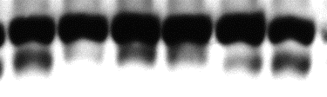

Lipidated LC3 isoform indicates autophagy unchanged
slow >
LC3
fast >
GAPDH
Dexa | - | - | + | + | + | +
Testo | - | - | - | - | + | +
LC3-II normalized to GAPDH
LC3-II normalized to LC3-I
Gastrocnemius, 7 day.
Sub-optimal normalization has been used by others to hypothesize role of autophagy.
Notes:
I also looked at LC3 in terms of protein levels. It has been quite hard to see the fast migrating, lipidated form, which is associated with autophagosomes, despite being able to see its slow migrating counterpart. And when I saw the fast-migrating LC3, I have noticed this ambiguous pattern. With dexamethasone, there is increase in lipidated LC3, if you normalize it to some unrelated, housekeeping protein, such as GAPDH. And testosterone co-administration suppresses it back. So now I became sympathetic to the other camp, those who claim glucocorticoids stimulate autophagy. But when I normalized lipidated LC3 to its precursor, the effect went away. PAUSE
This aspect cannot be better studied until accurate methods of measuring autophagy in vivo are designed. But with the tools that we have, it appears that testosterone doesn’t have an upregulated autophagy to suppress.

Slide 29
Calpain markers did not correlate with the phenotype
gastrocnemius calpain catalytic activity (rel.u.)
one day
three days
seven days
Also, no change in mu-calpain, calpastatin protein levels.
Notes:
Calcium chelation also slows down proteolysis in muscle. Turns out that meat scientists are very interested in calpains, a series of calcium dependent soluble proteases that make meat tender. Cardozo’s study said that testosterone represses an upregulation of calpain expression, so I thought it should be investigated. There was no change in protein levels of calpain ONE (also known as mu calpain), nor in its natural inhibitor calpastatin. The closest I got to an effect was using an enzymatic assay kit. Again, there isn’t much proteolytic activity for testosterone to repress.
So overall, among proteolytic systems, it appears that only proteasome-ubiquitin correlates with and may explain the phenotype.

Slide 30
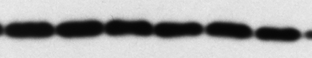


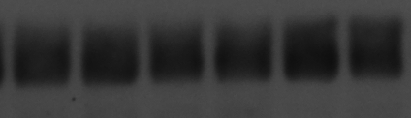
Translation regulators appear unchanged
Ⓟ-eIF2α
eIF3f
GAPDH
GAPDH
Dexa | — | — | + | + | + | +
Testo | — | — | — | — | + | +
Dexa | — | — | + | + | + | +
Testo | — | — | — | — | + | +
Ⓟ-eIF2α
eIF3-f
gastrocnemius, day 7
Notes:
I also wanted to look at the other side of the coin. As I said earlier, there are few studies measuring protein synthesis in response to dexamethasone, and they are not conclusive. I took an indirect approach, and looked at a few regulators of protein synthesis.
A commonly studied break on protein synthesis is phosphorylation on initiation factor 2. Testosterone did not seem to have an effect on that. NEXT
I also looked at initiation factor 3f. This was reportedly suppressed in a series of atrophy models. I could not see a change in that either.

Slide 31
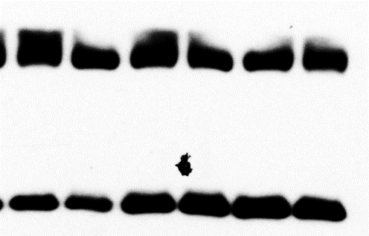
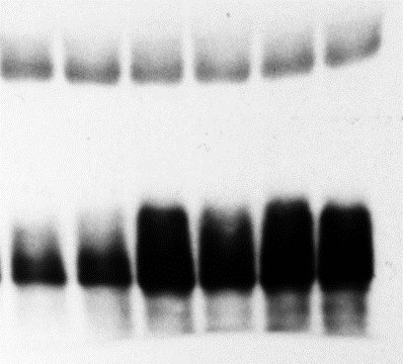
4E-BP is not inhibited by testosterone
GAPDH
GAPDH
Ⓟ-4EBP
total 4EBP
Dexa | — | — | + | + | + | +
Testo | — | — | — | — | + | +
Dexa | — | — | + | + | + | +
Testo | — | — | — | — | + | +
total 4EBP
Ⓟ-4EBP
gastrocnemius, day 7
Could not employ polysome profiling.
Notes:
Finally I looked at 4EBP, which I said is an inhibitor of protein synthesis. Despite Cardozo’s microarray data, there was not much effect of testosterone on its protein levels. NEXT
I also looked at phosphorylated 4EBP. This phosphorylation, you will recall, is inhibitory. However, unexpectedly, levels of phosphorylated 4EBP increased with dexamethasone. This may be an effect of increased 4EBP expression, driving up total and phosphorylated 4EBP. Once more, testosterone does not seem to contribute towards an anabolic effect.

Slide 32
Conclusions so far
Calpains, protein synthesis changes are less correlated with the phenotype.
Significant autophagy changes contrast with the phenotype.
Dexamethasone-induced loss of muscle is correlated with an increase in proteasome activity and E3 ligases expression.
Rescue by testosterone co-administration is best correlated with proteasome repression.
Notes:
So in conclusion, I was unable to prove changes in protein synthesis or calpains activity. There were changes in autophagy, but they contradicted the phenotype. The only metabolic pathway that correlated with the phenotype was ubiquitin – proteasome.

Slide 33
Testosterone pushes the transcriptional lever
quadriceps Foxo3a mRNA
quadriceps Klf15 mRNA
one day
three days
seven days
Notes:
So what molecular factors drive the rescue of muscle by testosterone? One way is to look a transcriptional mechanisms. I found that Foxo transcription factors 1m, 3a and 4 are stimulated by dexamethasone in multiple muscle groups and about any time I looked at. What was interesting was that at days 3 and 7, testosterone co-administration caused suppression of these transcription factors.
I also found a very similar profile for Klf 15. You may remember that Klf15 is a transcription factor that helps Foxo transcription factors in their atrogenes upregulation. I found that dexamethasone upregulates Klf15, and testosterone represses it down to basal levels.

Slide 34
IGF-I is partly restored by testosterone co-administration
quadriceps
IGF-I Ea mRNA
one day
three days
seven days
Notes:
I hypothesized that IGF-I is the lever that testosterone pushes back, in order to repress dexamethasone induced muscle loss. And indeed, across muscles and days, you see how dexemathasone suppresses IGF-I, and testosterone restores it.

Slide 35
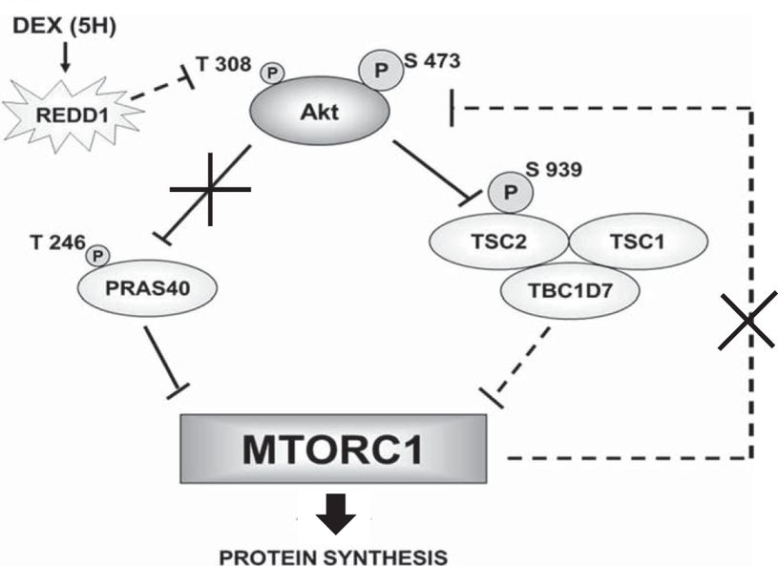
Even more Foxo activation
Britto et al., Am J Physiol, 2014.
Notes:
Moreover, there was a detail from Cardozo’s picture that skipped over. One other gene that is upregulated by dexamethasone and restored to basal levels by testosterone is REDD1. The reason I went past that earlier is that Cardozo listed REDD1 as an mTOR inhibitor. Since November last year, we know that it acts further upstream, and in fact inhibits Akt. How does it do it? A dashed line is all we have for now.
Nevertheless, the REDD1 knockout does not get dexamethasone-induced muscle loss, so it is a very important mediator.

Slide 36
Testosterone partly reverses REDD1 upregulation
gastrocnemius
REDD1 mRNA
quadriceps
REDD1 mRNA
one day
three days
seven days
Notes:
I measured REDD1 in my mice and found out that dexamethasone stimulates it, while testosterone repressed down to basal levels. Back then, I though am looking at an mTOR inhibitor, but now I know I have yet another way for Dexamethasone to inhibit Akt. So dexamethasone is predicted to inhibit Akt through increased Redd1, decreased IGF-I, and perhaps in some other ways, such IRS, p85. Testosterone is supposed to stop all these effects, and restore Akt. Will it it do it? NEXT

Slide 37
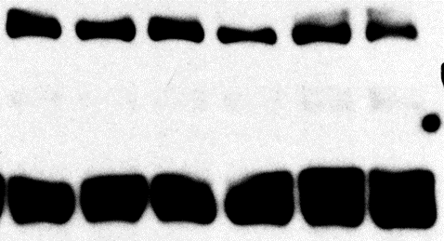
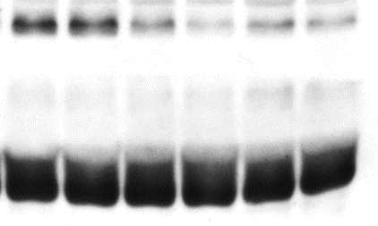
Akt (Ser 473) does not respond to testosterone
total Akt
Ⓟ473-Akt
GAPDH
GAPDH
Dexa | — | — | + | + | + | +
Testo | — | — | — | — | + | +
Dexa | — | — | + | + | + | +
Testo | — | — | — | — | + | +
total Akt
Ⓟ473-Akt
Ⓟ473-Akt /
total Akt
Gastrocnemius, 7 day.
Notes:
I am looking at just total Akt, and the steroids make no difference. And then I look at activated, phosphorylated Akt. And the answer is no, testosterone does not restore Akt in this assay. Dexamethasone reduced the activated form of Akt, but testosterone could not help it in a detectable manner.

Slide 38
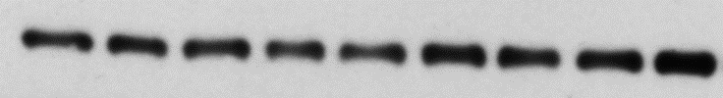

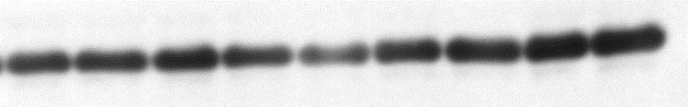
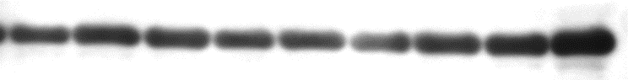
Akt (Ser 473) does not respond to testosterone in hypersensitive levator
total Akt
Ⓟ473-Akt
GAPDH
GAPDH
Dexa | — | — | — | + | + | + | + | + | +
Testo | — | — | — | — | — | — | + | + | +
Dexa | — | — | — | + | + | + | + | + | +
Testo | — | — | — | — | — | — | + | + | +
total Akt
Ⓟ473-Akt
Ⓟ473-Akt /
total Akt
Notes:
And not to give up, I went and looked a Akt in levator ani. You remember this muscle benefits the most from testosterone. And still, no change in total Akt, reduction in activated Akt with dexamethasone, and no rescue with testosterone.

Slide 39
Conclusions so far
Testosterone’s protective action is associated with restoration of Foxo signals.
Transcriptional mediators Klf15 and Foxo are altered by testosterone.
REDD1 and IGF-I are partly restored by testosterone.
Basal state repression of Akt by dexamethasone appears unchanged by testosterone co-administration.
Notes:
So at this point I see that the transcriptional cascade was there. Foxo and lf 15 were brought back to basal level, and that must have contributed towards the repression of atrogenes I showed earlier.
But I have two regulators of Akt being swayed by testosterone, and no change in Akt itself.

Slide 40
Hypotheses
Testosterone alleviates dexamethasone-induced muscle atrophy in mice.
Testosterone’s myoprotective action includes an anti-catabolic component.
Testosterone’s myoprotective action relies on inhibition of Foxo facilitated by restoration of IGF-I.
√
√
…
Notes:
So I am not done with the project. You see, I have shown that testosterone prevents dexamethasone-induced loss of muscle, that it does it by repressing the proteasome and Foxo. I even showed that IGF-I is restored by testosterone, but I couldn’t objectivize IGF-I downstream effects.
Remember all those caveats about how insulin and IGF-I signaling is interrupted by dexamethasone? How choosing a more metabolically active state makes dexamethasone appear important? It looks like I am in one of those situations, except I cannot make testosterone look better. Adding or removing insulin may make effects become more salient, but once you start changing those, you cannot say much about “restoration of IGF-I”.

Slide 41
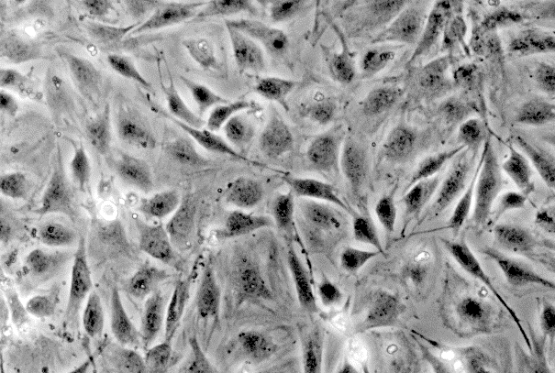
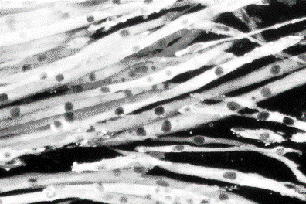
Dexa is anabolic, pro-proliferative for the undifferentiated muscle cells
Start differentiation
Serum-free medium
Time
(days)
Undifferentiated
Differentiated
Many studies discuss effect of the glucocorticoids or combination on proliferating or differentiating cells.
Many studies in rat cells.
Notes:
So I changed to an in vitro model. In vitro models of muscle cells share a few features. You start with mononucleate cells, change to serum-free medium when you reach confluence, and in a few days you get long, multinucleate cells. But there are a few catches. NEXT
Myoblasts collected from human donors die if they don’t get dexamethasone, as I found out the hard way. Turns out dexamethasone stimulates the proliferation of those mononucleate precursors. Quite a few studies were done at day 1 or 2 post-differentiation, when mononucleate proliferating cells are still around. These studies usually report that dexamethasone is an anabolic agent. NEXT
Luckily, if I may say so, most studies were done in rat cells. So, I was again left to discover doses effective in mice cells.

Slide 42
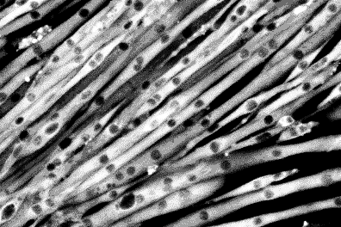
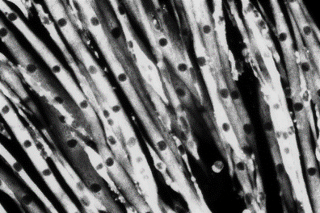
Cell diameter is rescued by testosterone co-administration
Start differentiation
Start pharmacological treatments
Diff. M.
±T±D
Time
(days)
Vehicle
Differentiated
50 µM Dexa
Dexa +
300 nM Testo
Notes:
An initial study was to just give them dexamethasone or the combination after seven days of differentiation. By that time, without serum, almost any proliferating cell was gone. You just look at the cells and see, well, not much.

Slide 43




Novel computer-assisted analysis
(B) Matlab
(A) Photoshop
average cell diameter (rel. u.)
Notes:
I ended up taking two microscopic fields and copying each cell, separately, on a huge canvas, using a semi-automated Photoshop tool called magic wand. Once you have that, Matlab can identify a cell contour, find its central axis (this brighter line in the center), and calculate diameters. Literally, these are operations described in an intro for Matlab beginners. NEXT
If you do that, you see that dexamethasone reduced myotube diameter by about 10%, and testosterone co-administration rescued the cells.

Slide 44
Total protein content is restored by testosterone co-administration
Start differentiation
Start pharmacological treatments
1 d
Diff. M.
±T±D
Time
(days)
2 d
Diff. M.
±T±D
total protein (normalized to first day)
At 48 hour, statistically significant difference between Dexa and Veh.
At 48 hour, statistically significant difference between Dexa and Dexa + Testo.
Notes:
I also did almost the same, but with steroids given one day, two days, three days. What you see is that dexamethasone causes a reduction of total protein in the cell culture dish. If you add testosterone, the cell protein content is rescued. So these are another line of evidence that in mice, testosterone prevents loss of muscle induced by dexamethasone.

Slide 45
Assaying protein synthesis in vitro
Start differentiation
Start pharmacological treatments
Diff. M.
6h (“0 d”)
±T±D
Time
(days)
³H-Phe
Diff. M.
1 d
±T±D
³H-Phe
Diff. M.
2 d
±T±D
³H-Phe
Diff. M.
3 d
±T±D
³H-Phe
Preliminary studies showed lack of sensitivity for 4h and 30h.
Notes:
I then did the same, had cells differentiate for seven day, and gave them steroids for 6 hours, 24 hours, 48, or 72. Now, I gave a radioactively labeled tracer to the cells for their last 6 hours of life. There was little uptake in the first 2 hour, and essentially no more uptake after 30 hours, so this is how I settled on the 6 hours.
The amount of tracer bound to cell proteins shows how much new protein was made, and is an indicator of protein synthesis rate.

Slide 46
Protein synthesis exhibits paradoxical, late increase
tracer enrichment
in cell protein
(fmol/g)
At 72 hour, statistically significant difference between Dexa and Veh.
At 72 hour, statistically significant difference between Dexa and Dexa + Testo.
No change in pattern if normalization is foregone.
Notes:
My findings were unexpected. In the first days, there was not much difference between treatments. But later, at 48 and 72 hours, there is more tracer uptake in the cells treated with dexamethasone than in those that did not receive dexamethasone. So it appears that dexamethasone treated cells synthesize more protein. PAUSE
I am talking about cells that have been in dexamethasone for three days, and therefore shrunk. So it could be that these cells appear more enriched because, when you divide by total protein, you divide by less. But if you don’t normalize, and only show how much tracer is in a dish, you still see more tracer taken intro protein in the dexamethasone-treated cells. So that suggests that indeed dexamethasone-treated cells get better at synthesizing protein after a few days of protein loss. My interpretation is that lateness and direction against the phenotype are showing protein synthesis as a reactive phenomenon, caused by feedback.
Interestingly, testosterone coadministration makes these cells behave as if they received neither drug. This also suits the feedback hypothesis. As I showed earlier, total protein is not lost in cells treated with the combination, and therefore there is no feedback.

Slide 47
Assaying protein degradation in vitro
Start differentiation
Start pharmacological treatments
Diff. M.
Time
(days)
0 d
±T±D
³H-Phe
Diff. M.
1 d
±T±D
³H-Phe
Diff. M.
2 d
±T±D
³H-Phe
Diff. M.
3 d
±T±D
³H-Phe
Preliminary studies showed very low tracer uptake past 48 hour.
Notes:
I also measured the rate of protein degradation.

Slide 48
Protein degradation correlates with phenotype
medium to cell protein tracer ratio
At 24 hour, statistically significant difference between Dexa and Veh.
At 24 hour, statistically significant difference between Dexa and Dexa + 500 nM Testo.

Slide 49
Inhibitor tests in vitro
Protein
labeling
Start steroid
treatments
Start
differentiation
Diff. M.
Time (days)
±T±D
³H-Phe
Collection of measured medium

Slide 50
Proteasome is responsible for bulk digestion
medium to cell protein tracer ratio
Strongest inhibition of proteolysis with proteasome inhibitor MG132.
Non-negligible effect of lysosome inhibitor chloroquine.
Repression to basal level with T co-administration.
IGF1R inhibitor did not alter T effect.

Slide 51
Cell model conclusions
Muscle cells are protected by testosterone co-administration.
Protein degradation, more than protein synthesis, is correlated with total protein, and could explain testosterone effects.

Slide 52
Limitations
I could not observe IGF-I downstream effects, perhaps due to overriding circumstances.
Role of Foxo, Akt, REDD1 was studied in observational manner.
There is no direct method of measurement for autophagy. Protein synthesis assays are almost as good.

Slide 53
General model
Glucocorticoids
Anabolic steroids
REDD1
IGF-I
Akt
Foxo
MuRF1
proteasome / ubiquitin - mediated catabolism

Slide 54

Acknowledgements

